Slide 1

Lesson-16
李老师& 开课吧人工智能学院课程组
2020.05

Slide 2
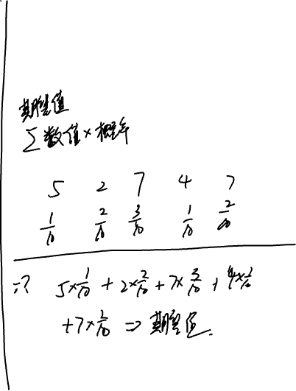
Overview
Reinforcement Learning
Concepts
Bellman equation
Dynamic programming
Monte-Carlo methods
TD
Q-learning and SARSA
Deep Q-Network & Policy gradient
RL and NLP

Slide 3
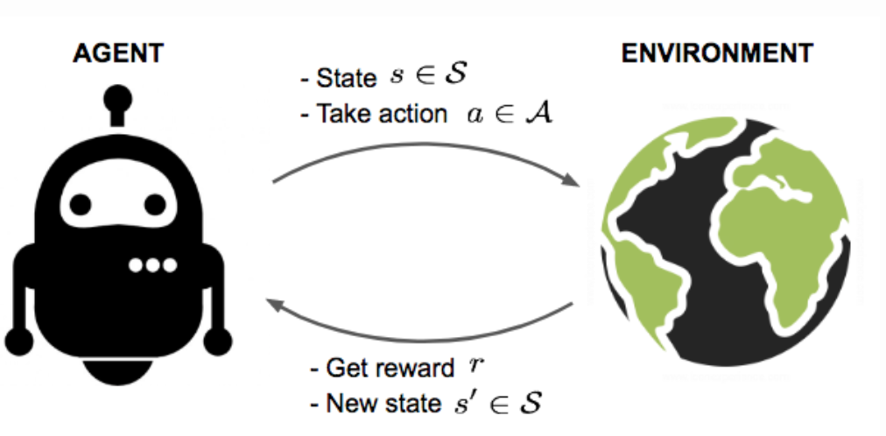
What is reinforcement learning

Slide 4
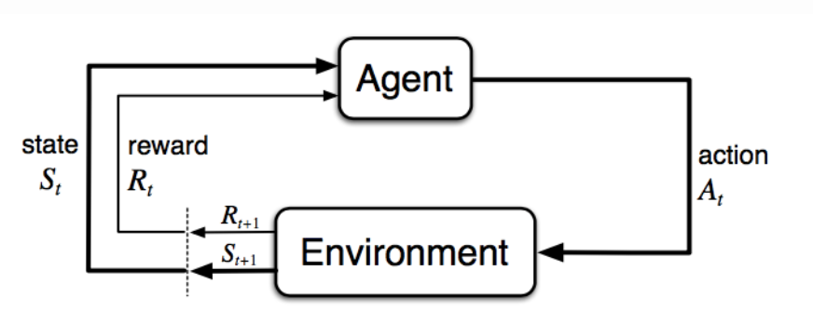
Some important concepts
States
Actions
Rewards
Values
Policy
Episode

Slide 5
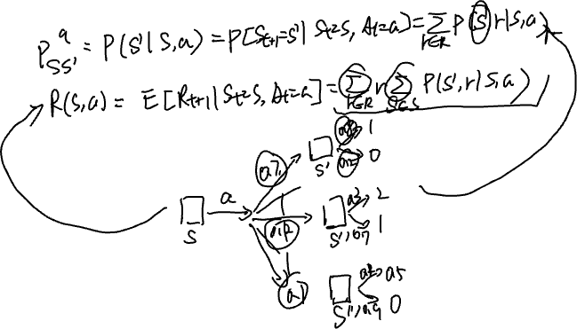
Model transition

Slide 6
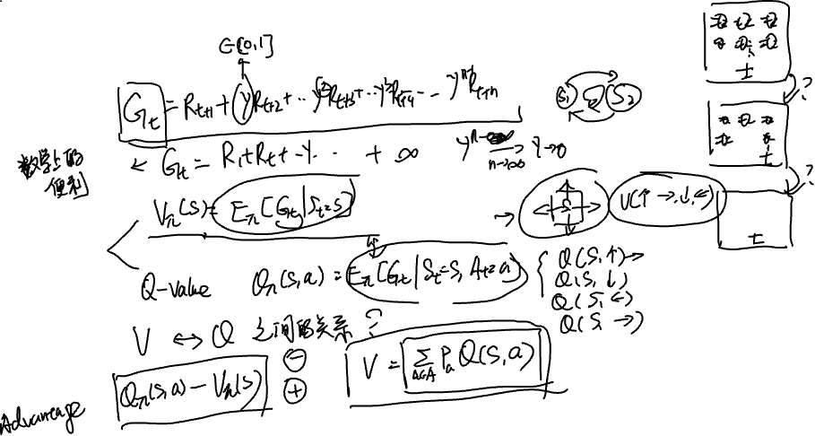
Value function and action-value(Q-value)
Rewards:
State values:
Q-values:
A-values:

Slide 7
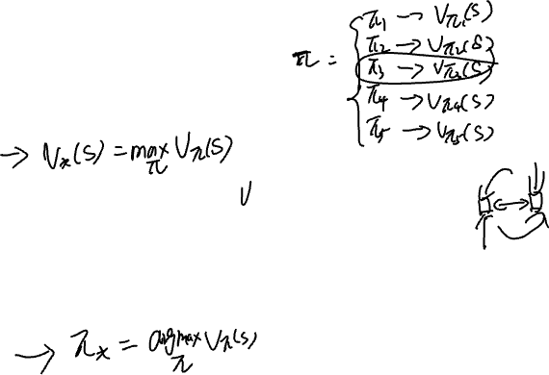
Optimal Value and Policy
What is the optimal value for a state ?
What is the optimal optimal policy if we know the optimal values?

Slide 8
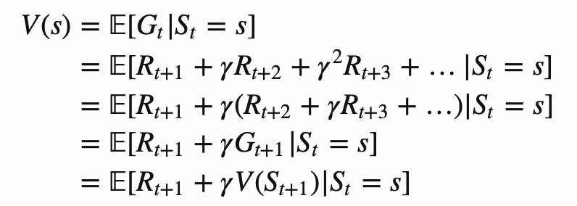




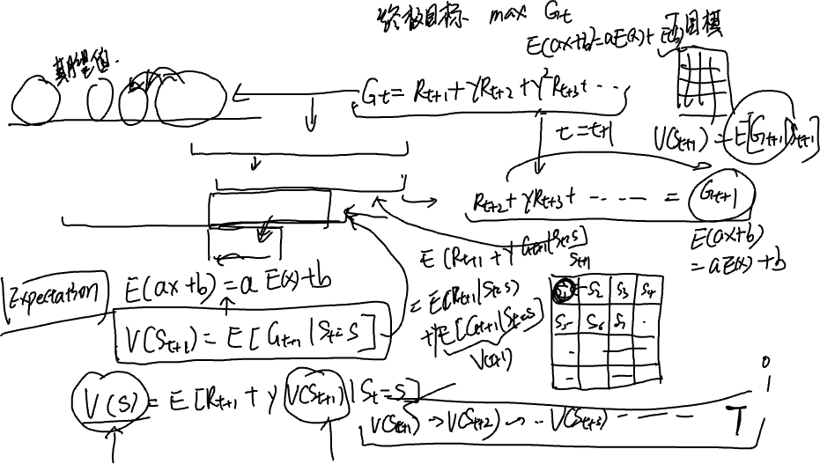



Bellman equations (1)

Slide 9
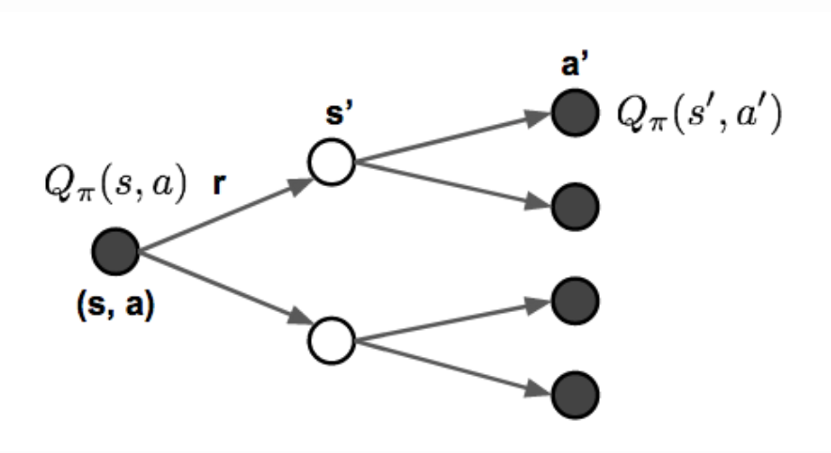
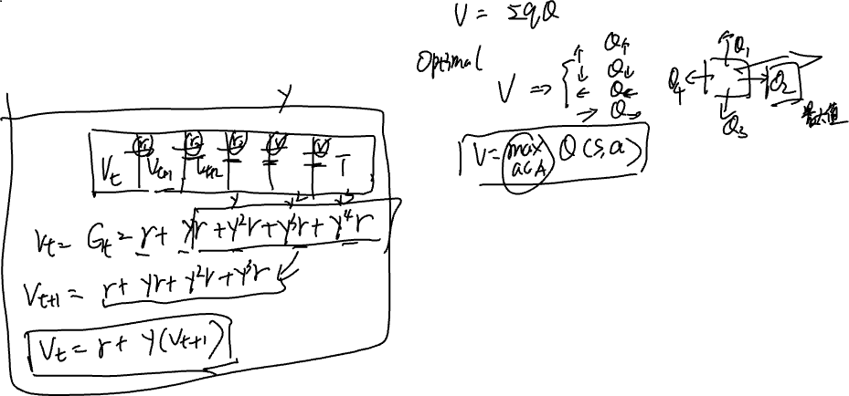
Bellman equations (2)

Slide 10
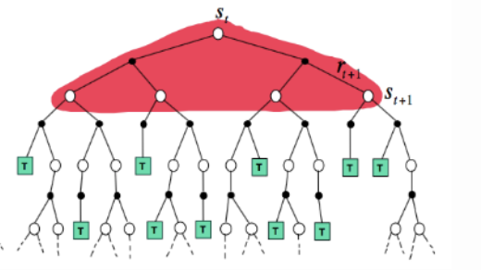
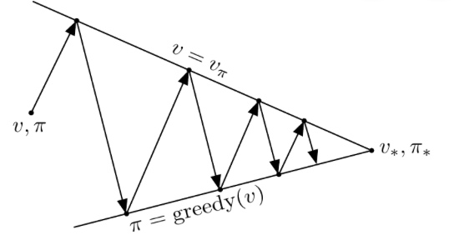
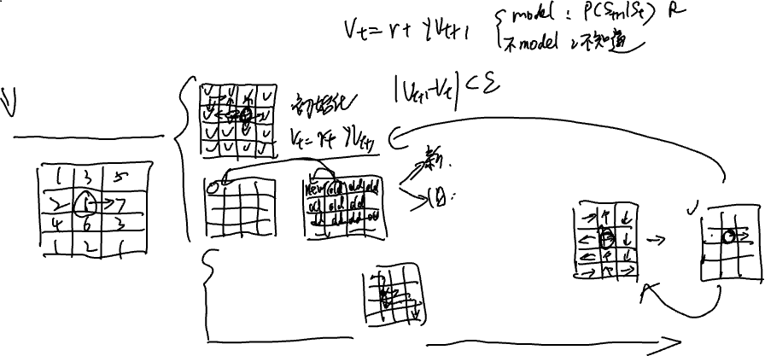

Dynamic programming
Value iteration
Policy evaluation
Policy iteration
Policy improve

Slide 11
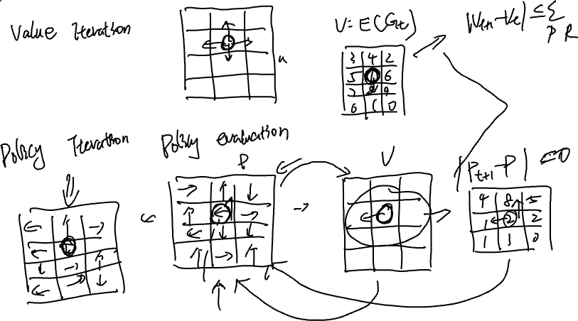

Slide 12
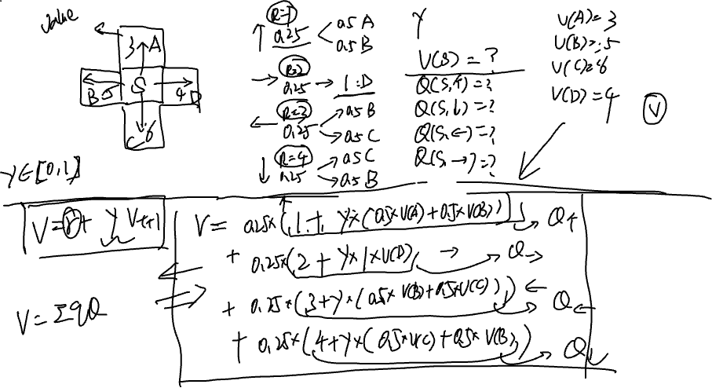

Slide 13
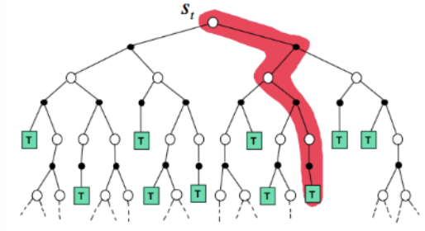
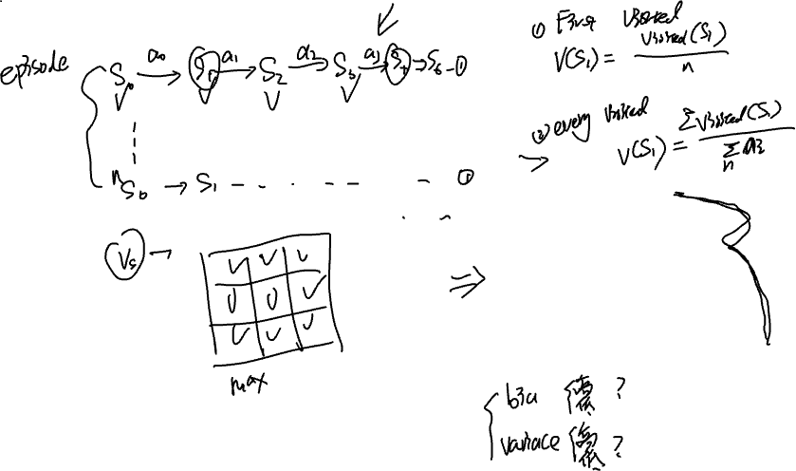
Monte-Carlo Methods

Slide 14
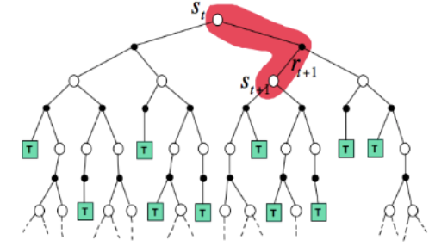




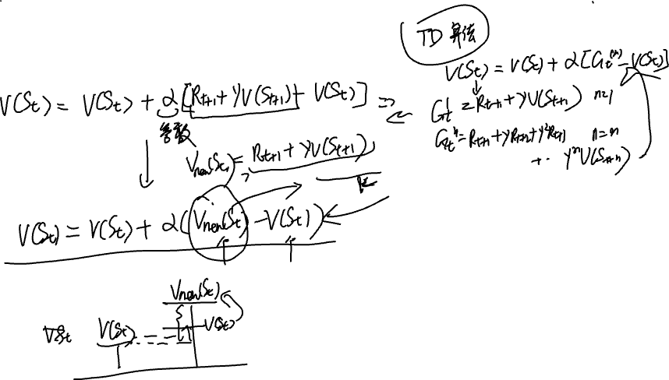




Temporal-Difference Learning

Slide 15
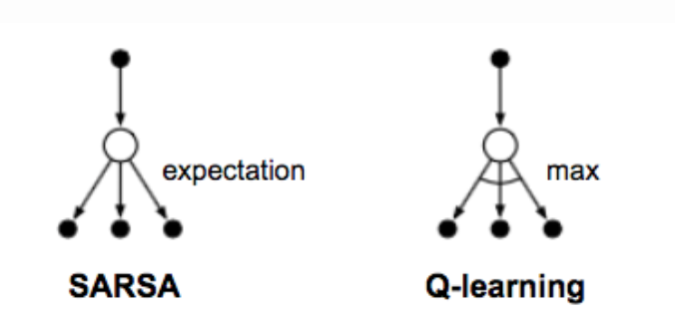
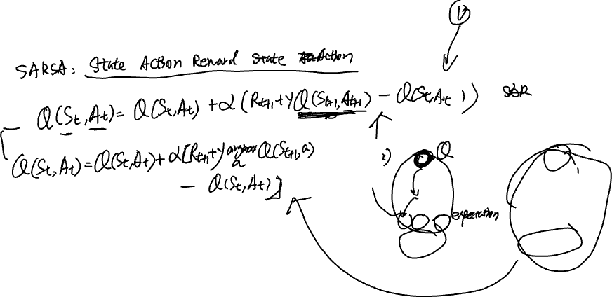


Q-learning and SARSA

Slide 16
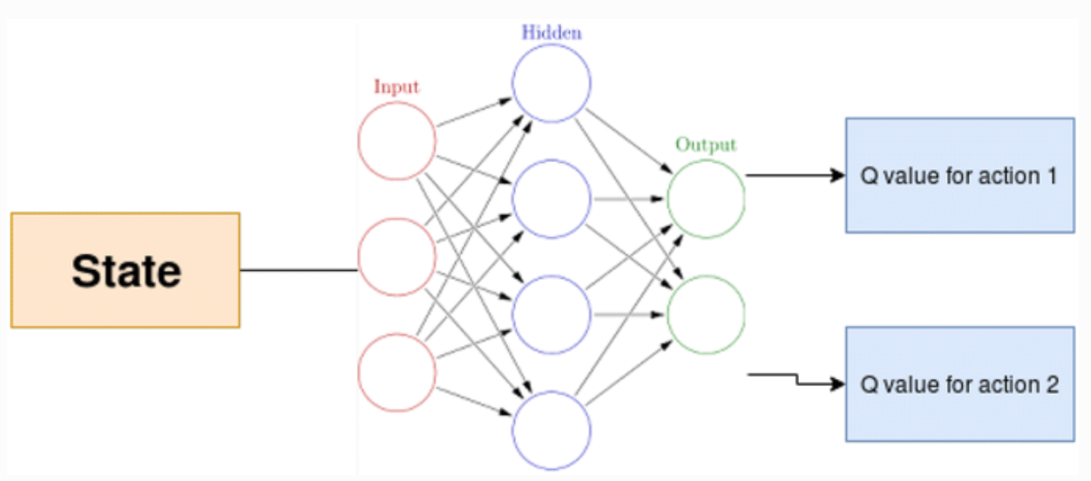
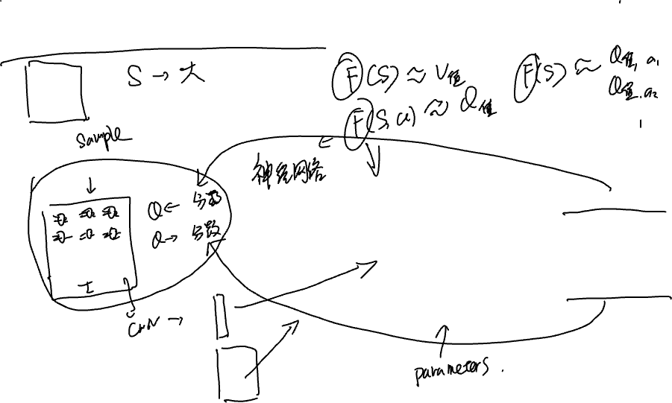
Function approximation (Deep Q-Network)

Slide 17
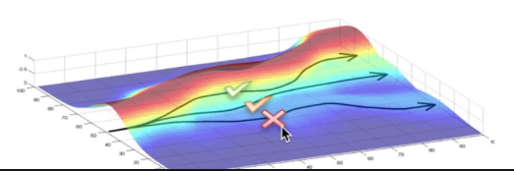
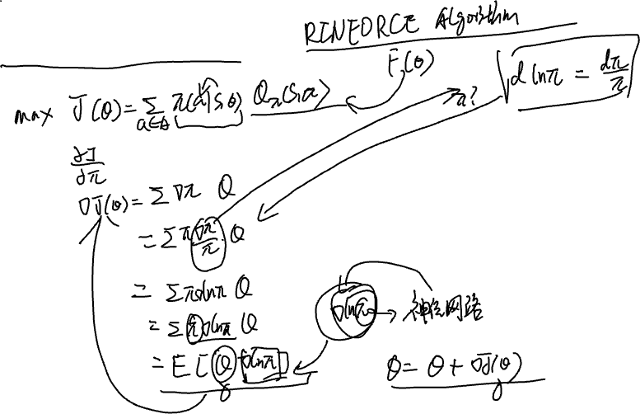
Policy gradient

Slide 18
Case study

Slide 19

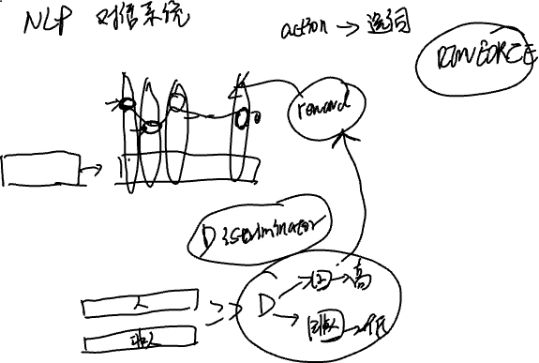
When RL meets NLP.

Slide 20

Thanks for your attention!

